Slide 1
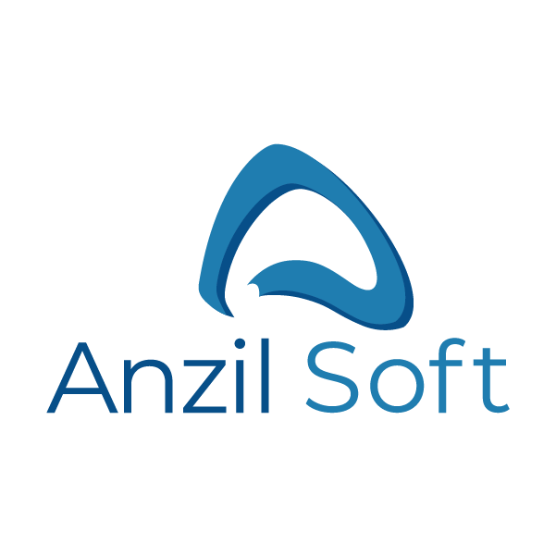
Company Introduction
Our focus
Technology focused team providing niche services to world class companies. Driven by aspiration to be big and bitten by Quality execution.

Slide 2
Who we are
We are a team of individuals who are passionate about technology.
We leverage our rich experience in emerging technologies to deliver innovative solutions that accelerate our clients’ Digital Transformation initiatives.
We have always considered our Client as partner in its growth. We partner with clients to create and support innovative solutions; that help businesses become a lasting success in the marketplace.

Slide 3
How We Differentiate
IPR Protection
R&D extended to customers
We work very transparently with customer, our team members are also trained and sensitized in handling Customer IP.
Our team of results-driven R&D experts will support you at any point during the product development cycle. Whether you face a strategic pivot or hit a roadblock — we’ve got you covered all the way
Quality execution & scaling
Rich experience
Team members spend good number of hours in training and learning best industry practices. While focus is quality execution, founder members also bring in experience to scale teams
Our founder members have worked in Fortune 500 companies, have inculcated best practices from global players.

Slide 4
Our services
Custom Software Development
Whether you are a start-up or an established business, we are ready to assist you at every stage of the software development life cycle — from conceptualization and consulting to development and support.
Web Application Development
Our software engineers have a wealth of experience in building web applications. We are also experts in many verticals and business domains, including e-Commerce, e-Learning, AdTech, Finance, Entertainment, Benefit Administration and more.

Slide 5
Our services
Mobile Application Development
Develop powerful, highly usable mobile apps that solve business problems, attract users, and reinforce your brand. We build native, hybrid, and cross-platform apps that run on all major operating systems such as iOS and Android.
Application Maintenance and Enhancements
Modern business enterprises and corporate clients have many applications and software products in use at all times. It is usually necessary to make small updates and enhancements to the features. It becomes essential for the internal IT department to respond with a wide range of technical skills and a spectrum of service issues. We take application enhancement and maintenance services seriously to build enduring relationships with clients.

Slide 6
Our services
Big Data & Analytics
For enterprises and ISVs, big data analytics offers the opportunity to gather and analyze large amounts of data in order to uncover insights that help the business stay agile and competitive. With machine learning, organizations can realize additional value through continuous learning as well as automation and business optimization. We can help, with expertise in the leading edge Big Data & Analytics technologies and platforms. We can both nimbly execute prototypes and scale the solutions that work – to get you to value faster.

Slide 7
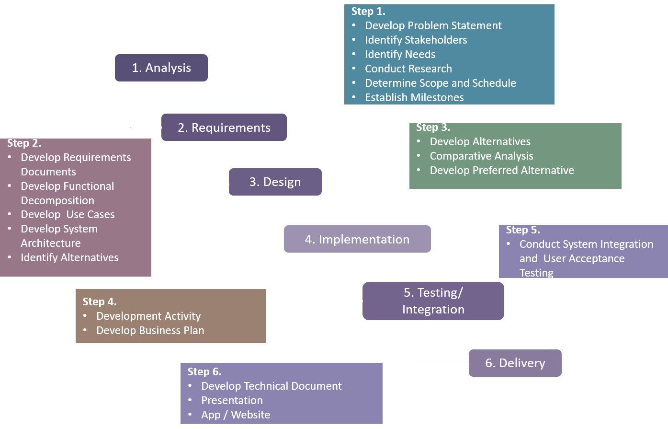
Our Development Process

Slide 8
Why Anzil Soft
More Business Value
Once you have crossed our doorstep, our R&D and BA experts are ready to go the extra mile to fully grasp your idea and make sure we know what users really want. We work hand-in-hand with your stakeholders to develop an app that evolves along with your business and users, whatever challenge comes our way.
Rapid Results
To help you outrun the competition, we aim to shrink the gap between your idea and a winning solution. Our mobile team has a knack for rapid prototyping and agile development, which enables you to actively engage in the project and make smarter product decisions from day one.

Slide 9
Why Anzil Soft
Transparency
Not only do you stay in control and fully updated on the project status, but your feedback is critical to the continuous improvement of your mobile solution. Our team uses daily reports, video calls, email updates and onsite visits to address all your ideas and concerns.
Great UX and UI Expertise
We want your app to stand out at first glance, reflect your brand identity, and provide experiences that get users hooked. We follow the do’s and don’ts from Apple and Google to build designs that are easy to adopt and a pleasure to use.

Slide 10
Technology Caliber
ASP.NET
MVC
.NET Core
C#
VB.NET
BizTalk
Microsoft Azure
MS Service Fabric
MS SQL Server
Angular
Knockout JS
React JS
Node JS
HTML 5
Bootstrap
jQuery
PHP
Word Press
Web API
Java Spring Framework
Big Data
Hadoop
Maria DB
Oracle
Mongo DB
AWS
Android SDK
iOS
Ionic
Phone Gap

Slide 11
Case Study
Project Brief
Anzil Soft works with a Wespath United Methodist Church Organization to provide the solution for the business problem. We have designed and developed the enterprise product as solution.
Project Type – User Research + Product Conceptualization + Design + Development Delivery + Maintenance and Support
Goals
Digitalize the entire process as enterprise product to provide rich UI experience ,improve quality of services, increase the percentage plan transactions, reduce operational cost
Scalable and Maintainable solution at an Enterprise level
Challenge
Customer is looking for the solution which can ease the remote administration, one stop solution for managing indicative data, health and welfare plans
Multiple third party system integration like “Benefit Solver Health System, UNUM Welfare System and OMNI benefit administration”
Approach
Proposed the solution of web responsive portal development
Hybrid mobile app for participants
Realtime Integration of third party system using middleware
Designed and developed the background processes for seamless communication with different systems

Slide 12
Case Study
Project Brief – Future Event Processing
Anzil Soft works with a Wespath United Methodist Church Organization to provide the solution for the business problem. We have designed a solution to process system data on a specific date in future as provided by the end user.
Project Type – User Research + Product Conceptualization + Design + Development Delivery + Maintenance and Support
Goals
Document and Digitalize the entire process to meet the requirement of executing certain system records on a specific date
Design and develop a robust and scalable system to cater the need of processing several thousand records in a very limited time period.
Challenge
Customer was looking for the solution which can ease the execution of some yearly data to be processed on a very specific date.
Maintaining the integration with third party system (OMNI), while processing such data.
Should be processed only during stipulated time window available for such processing.
Approach
Proposed a solution of multi-thread process to mange the high volume and limited time.
Configurable threads to map the scalability with available hardware and network resources.
Realtime Integration with OMNI to keep the data integrity intact.
Designed and developed the processes for seamless execution with many configurable parameters to customize as per need.

Slide 13
Case Study
Project Brief – Real Time Multiple System Integration For Bulk Transactions
Anzil Soft works with a General Board Of Pension IPS department to provide the solution for the business problem. We have designed and developed the robust solution for bulk file upload with transaction tracking and notification across multiple systems.
Project Type – User Research + Product Conceptualization + Design + Development Delivery + Maintenance and Support
Goals
Solution for Realtime long running atomic transaction for bulk transaction processing in specific time period
Developed robust scalable solution for real time multiple system integration with seamless system communication
Provide Notification and Tracking framework
Challenge
Customer is looking for the solution which can ease the real time multiple system integration for bulk transactions
Security is one of the major priority as sensitive data is exchanged among systems
All the transactions need to be atomic and notification at multiple point.
Need the roll back option in case of failure at any time.
Approach
Proposed the solution of bulk upload files processing using BizTalk middleware to integrate multiple systems
Developed customized framework for throttling and record processing by measuring the system parameters.
Handled security using SAML implementation
Developed tracking and notification system to track the progress at each state in database.

Slide 14
THANK YOU AND QUESTIONS
THANK YOU

